Slide 1
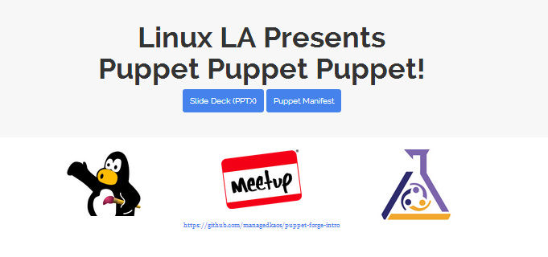
This site is on Github. Serve it from Apache….NOW!

Slide 2
A Brief Introduction to The Puppet Forge (and Modules)
Find, Install, Apply
Michael Jenkins michael@managedkaos.com

Slide 3
Goals
Find the modules we need by searching the Puppet Forge
Install the modules from the command line
Apply the modules and verify system operation
Notes:
Install Apache, configure the vhost, and serve content from GitHub

Slide 4
https://forge.puppetlabs.com
Puppet Forge
“A repository of modules written by the community and Puppet Labs.”
Puppet Module
“Modules are reusable, sharable units of Puppet code.”

Slide 5
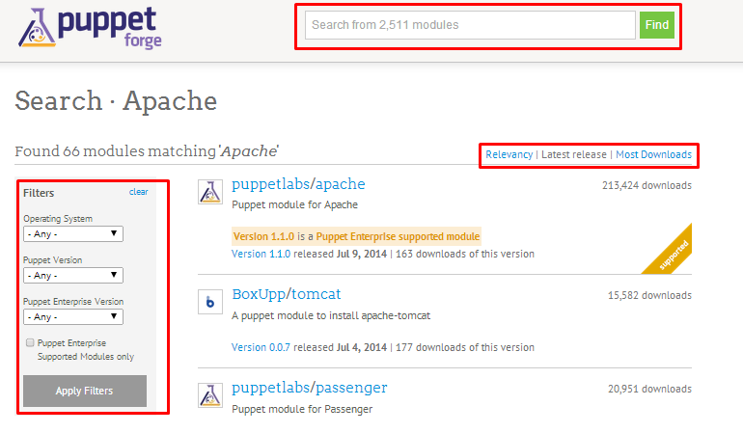
Find Modules – Search, Sort, Filter
Search on keywords; Sort by details; Filter on OS and Versions, and Supported Modules

Slide 6
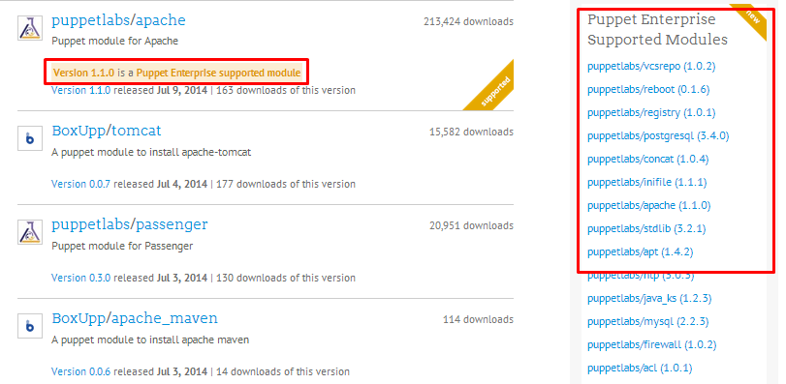
Find Modules – Choosing the right one
Research; Experimentation; Puppet Supported Modules

Slide 7
https://forge.puppetlabs.com/supported
Puppet Labs guarantees that each supported module…
…Has been tested with Puppet Enterprise
…Is subject to official Puppet Labs Puppet Enterprise support
…Will be maintained with bug or security patches as necessary
…Is tested on and ensured compatible with multiple platforms

Slide 8
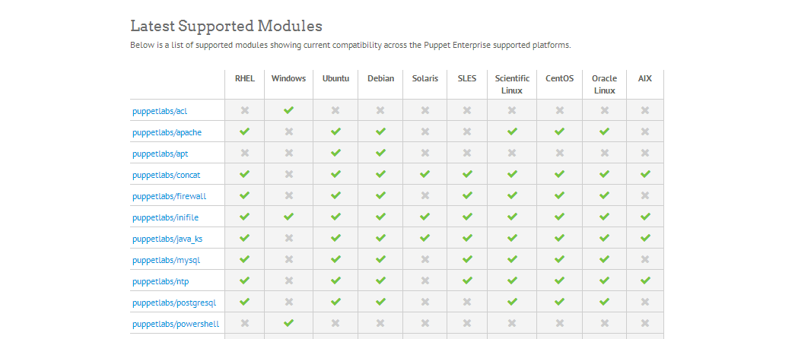
Latest Support Modules Listed on https://forge.puppetlabs.com/supported

Slide 9
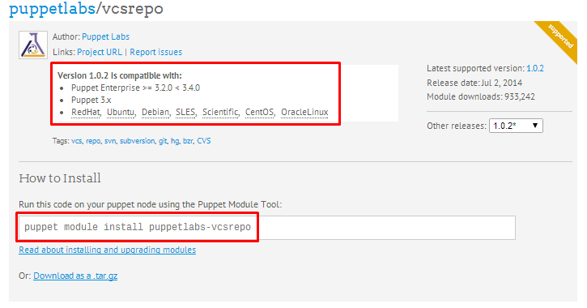
Find Modules – Check compatibility and installation details
Notes:
For our goal, use the puppetlabs sponsored modules for apache and vcsrepo:
puppetlabs/apache
puppetlabs/vcsrepo

Slide 10
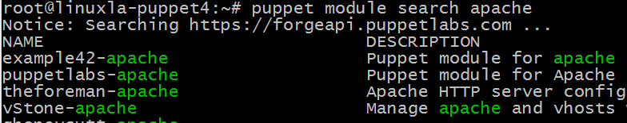
Find Modules
Search the Puppet Forge from the command line too:
$ puppet module search apache
Notes:
Use the “module search” commands to find the module
Does not have options for filtering or sorting results by default

Slide 11
Install Modules
Use the puppet command with “module install <module name>”
# puppet module install puppetlabs-apache
Installation locations:
Root – /etc/puppet/modules
User – /home/username/.puppet/modules

Slide 12
Install Modules
# puppet module install puppetlabs-apache
Notice: Preparing to install into /etc/puppet/modules
Notice: Downloading from https://forgeapi.puppetlabs.com
Notice: Installing -- do not interrupt ...
/etc/puppet/modules
└─┬ puppetlabs-apache (v1.1.0)
├── puppetlabs-concat (v1.1.0)
└── puppetlabs-stdlib (v4.2.2)

Slide 13
Install Modules
Display the modules that are installed with “module list”
# puppet module list
/etc/puppet/modules
├── puppetlabs-apache (v1.1.0)
├── puppetlabs-concat (v1.1.0)
├── puppetlabs-stdlib (v4.2.2)
└── puppetlabs-vcsrepo (v1.0.2)

Slide 14
Apply Modules
Call out installed modules in a puppet manifest
$ vi apache-vcsrepo.pp
# instantiate the apache class
class { 'apache': }
# clone the repository
vcsrepo { $docroot: …}
$ sudo puppet apply apache-vcsrepo.pp

Slide 15
Apply Modules
Confirm that the modules were applied properly with “puppet resource” command (or built-in commands)
Package:
puppet resource package git
File:
puppet resource file /www
Service:
puppet resource service apache2

Slide 16
DEMO
Install the latest version of Puppet Enterprise. Search the Puppet Forge to find the modules we need to reach our goal.
Check the environment before we install and apply modules
Install apache and vcsrepo modules; Draft and apply a manifest
Check the environment to confirm and validate the installations

Slide 17
BACKUP INFO

Slide 18
Demo Step #1: Install Puppet
# Install Puppet (on Ubuntu 12.04 LTS)
wget https://apt.puppetlabs.com/puppetlabs-release-precise.deb
dpkg -i puppetlabs-release-precise.deb
apt-get update
apt-get install -y puppet
puppet --version

Slide 19
Demo Step #2: Pre-Check
# Check the Environment Before installing and applying modules
puppet module list
which git
puppet resource package git
service apache2 status
puppet resource service apache2
curl -s -w "%{http_code}\n" -o /dev/null `hostname`.cloudapp.net

Slide 20
Demo Step #3: Install Modules
# Install the modules and apply a puppet manifest
puppet module install puppetlabs-vcsrepo
puppet module install puppetlabs-apache
wget https://raw.githubusercontent.com/managedkaos/puppet-forge-intro/master/apache-vcsrepo.pp
sudo puppet apply apache-vcsrepo.pp

Slide 21
Demo Step #4: Post-Check
# Confirm that the modules, applications, and site are installed
puppet module list
puppet resource package git
service apache2 status
puppet resource service apache2
curl -s -w "%{http_code}\n" -o /dev/null `hostname`.cloudapp.net

Slide 22
Fixing the “templatedir” Warning
If you run commands as root on a new install and see:
Warning: Setting templatedir is deprecated.
See http://links.puppetlabs.com/env-settings-deprecations
(at /usr/lib/ruby/vendor_ruby/puppet/settings.rb:1095:in `issue_deprecations')
Edit puppet.conf and comment out “templatedir=$confdir/templates”
$ sudo vi /etc/puppet/puppet.conf
This provides a quick fix for an annoyance but may introduce other issues!

Slide 23
Installing Modules from Source
Using “puppet module install” command may not always be an option
Examples: Disconnected networks, firewalls, local development
Modules can be downloaded from the forge and installed manually
http://docs.puppetlabs.com/puppet/latest/reference/modules_installing.html#installing-from-a-release-tarball
$ puppet module install <module name>.tar.gz --ignore-dependencies
Dependencies will have to be installed manually as well

Slide 24
Puppet Help and Manual Pages
puppet help module – usage and overview
puppet man module – detailed information, subcommands, options
puppet help module search – usage and overview for the search subcommand

Slide 25
Apply Modules
Confirm that the modules were applied properly with “puppet resource package/service/file” command (or built-in commands)
$ puppet resource service apache2
$ service apache2 status

Slide 26
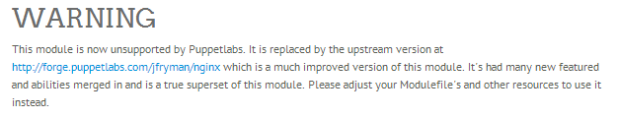
Not all Supported Modules are Created Equally
puppetlabs/nginx replaced by jfryman/nginx

